Slide 1
Design and Analysis of Algorithms
Asymptotic Notations

Slide 2

Asymptotic Upper Bound
$$f\left(n\right)≤ g\left(n\right) for all n≥ n0$$
$g(n)$ is an asymptotic upper bound on $f(n)$.
$$f\left(n\right)= O\left(g\left(n\right)\right) iff ∃ c,n_{0} :f\left(n\right)≤ cg\left(n\right) ∀n≥ n0$$
g(n)
f(n)
T_{t}
1
n₀
n

Slide 3

Asymptotic Lower Bound
$$f\left(n\right)≥g\left(n\right) for all n≥ n0$$
$g(n)$ is an asymptotic lower bound on $f(n)$.
$$f\left(n\right)=Ω\left(g\left(n\right)\right) iff ∃ c,n_{0} :f\left(n\right)≥ cg\left(n\right) ∀n≥ n0$$
f(n)
g(n)
T_{t}
1
n₀
n

Slide 4
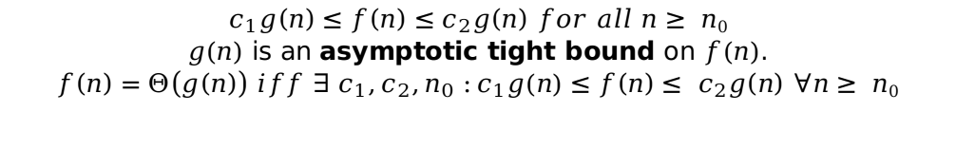
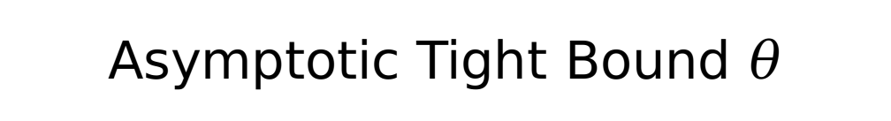
Asymptotic Tight Bound $θ$
$$c_{1}g\left(n\right)≤f\left(n\right)≤c_{2}g\left(n\right) for all n≥ n0$$
$g(n)$ is an asymptotic tight bound on $f(n)$.
$$f\left(n\right)=Θ\left(g\left(n\right)\right) iff ∃ c_{1},c_{2},n_{0} :c_{1}g(n)≤f\left(n\right)≤ c_{2}g\left(n\right) ∀n≥ n0$$
c₂g(n)
f(n)
c₁g(n)
n₀
n

Slide 5

Asymptotic Strictly Upper Bound
$$f\left(n\right)< g\left(n\right) for all n≥ n0$$
$g(n)$ is an asymptotic strictly upper bound on $f(n)$.
$$f\left(n\right)=o\left(g\left(n\right)\right) iff ∃ c,n_{0} :f\left(n\right)≤ cg\left(n\right) ∀n≥ n0$$
g(n)
f(n)
T_{t}
1
n₀
n

Slide 6

Asymptotic strictly Lower Bound
$$f\left(n\right)>g\left(n\right) for all n≥ n0$$
$g(n)$ is an asymptotic strictly lower bound on $f(n)$.
$$f\left(n\right)=ω\left(g\left(n\right)\right) iff ∃ c,n_{0} :f\left(n\right)≥ cg\left(n\right) ∀n≥ n0$$
f(n)
g(n)
T_{t}
1
n₀
n

Slide 7
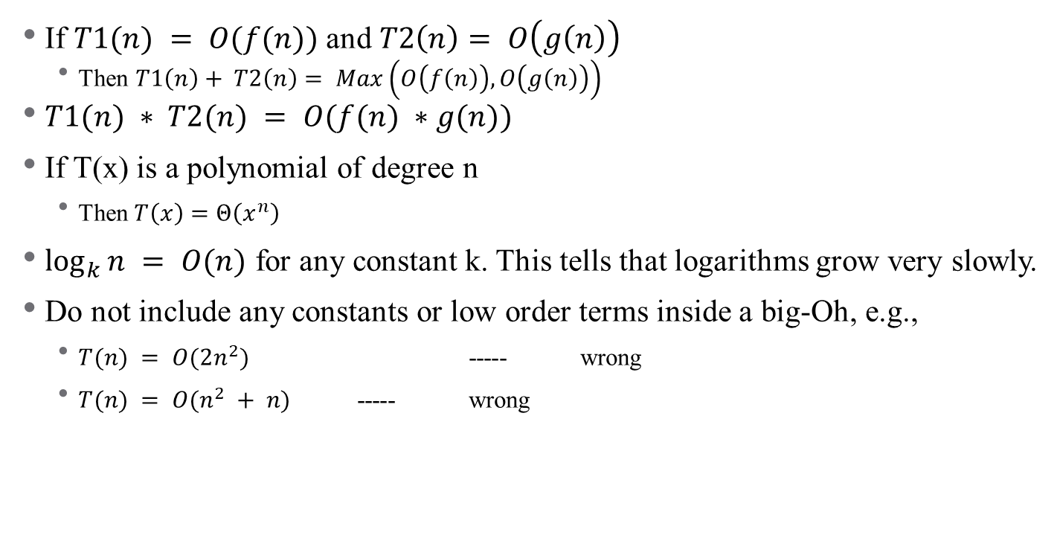
Some Rules About Asymptotic Notation
If $T1(n) = O(f(n))$ and $T2\left(n\right)= O\left(g\left(n\right)\right)$
Then $T1\left(n\right)+ T2\left(n\right)= Max\left(O\left(f\left(n\right)\right), O\left(g\left(n\right)\right)\right)$
$T1(n) ∗ T2(n) = O(f(n) ∗g(n))$
If T(x) is a polynomial of degree n
Then $T\left(x\right)=Θ\left(x^{n}\right)$
$\log_{k}{n} = O(n)$ for any constant k. This tells that logarithms grow very slowly.
Do not include any constants or low order terms inside a big-Oh, e.g.,
$T(n) = O(2n^{2})$ ----- wrong
$T(n) = O(n^{2} + n)$ ----- wrong

Slide 8
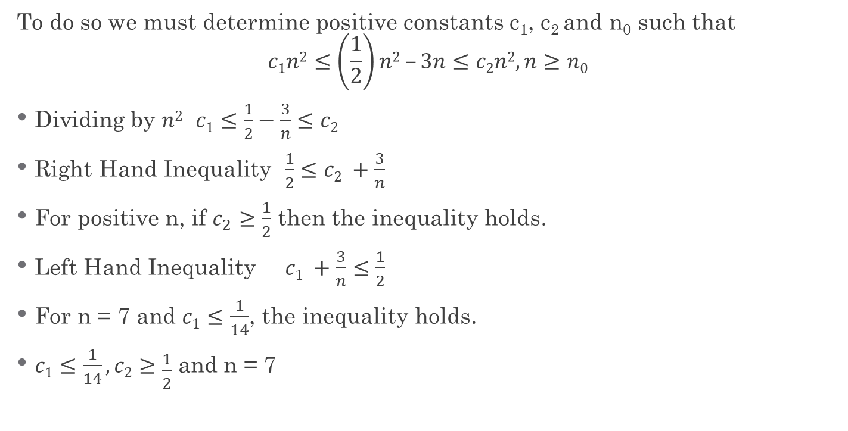
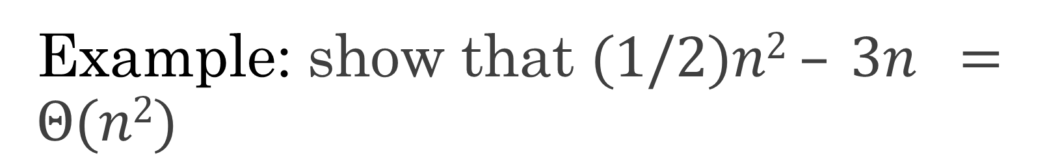
Example: show that $(1/2)n2 – 3n =Θ(n2)$
To do so we must determine positive constants c₁, c₂ and n₀ such that
$$c1n2≤\left(\frac{1}{2}\right)n2 –3n≤c2n2, n≥n0$$
Dividing by $n2$ $c1≤\frac{1}{2}−\frac{3}{n}≤c2$
Right Hand Inequality $\frac{1}{2}≤c2 +\frac{3}{n}$
For positive n, if $c_{2}≥\frac{1}{2}$ then the inequality holds.
Left Hand Inequality $c1 +\frac{3}{n}≤\frac{1}{2}$
For n = 7 and $c1≤\frac{1}{14}$, the inequality holds.
$c1≤\frac{1}{14}, c2≥\frac{1}{2}$ and n = 7

Slide 9
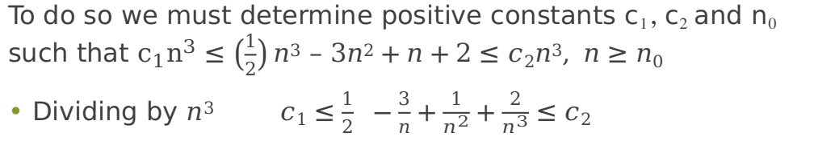
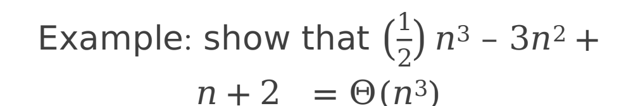
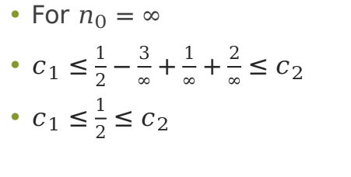
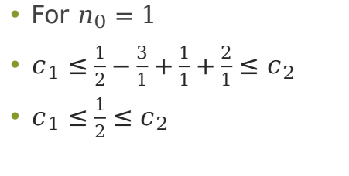
Example: show that $\left(\frac{1}{2}\right)n3 – 3n2+n+2 =Θ(n3)$
To do so we must determine positive constants c₁, c₂ and n₀ such that $c_{1}n^{3}≤\left(\frac{1}{2}\right)n3 – 3n2+n+2≤c2n3, n≥n0$
Dividing by $n3$ $c1≤\frac{1}{2} −\frac{3}{n}+\frac{1}{n^{2}}+\frac{2}{n^{3}}≤c2$
For $n_{0}=1$
$c_{1}≤\frac{1}{2}−\frac{3}{1}+\frac{1}{1}+\frac{2}{1}≤c_{2}$
$c_{1}≤\frac{1}{2}≤c_{2}$
For $n_{0}=∞$
$c_{1}≤\frac{1}{2}−\frac{3}{∞}+\frac{1}{∞}+\frac{2}{∞}≤c_{2}$
$c_{1}≤\frac{1}{2}≤c_{2}$

Slide 10
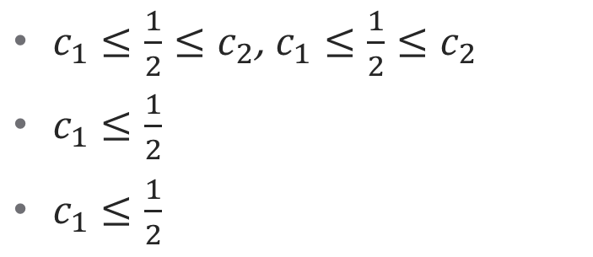
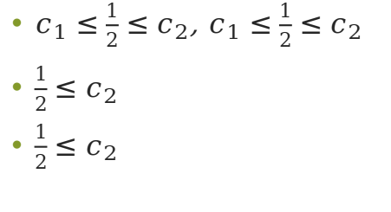
Example: show that $\left(\frac{1}{2}\right)n3 – 3n2+n+2 =Θ(n3)$
$c_{1}≤\frac{1}{2}≤c_{2}$, $c_{1}≤\frac{1}{2}≤c_{2}$
$c_{1}≤\frac{1}{2}$
$c_{1}≤\frac{1}{2}$
$c_{1}≤\frac{1}{2}≤c_{2}$, $c_{1}≤\frac{1}{2}≤c_{2}$
$\frac{1}{2}≤c_{2}$
$\frac{1}{2}≤c_{2}$

Slide 11
Standard Functions

Slide 12
Execution time (1 nano second/instruction)

Slide 13
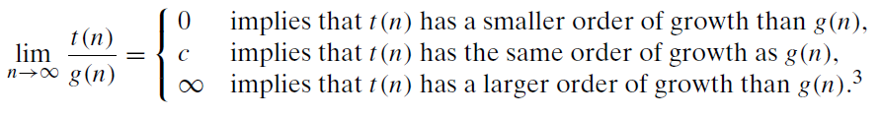
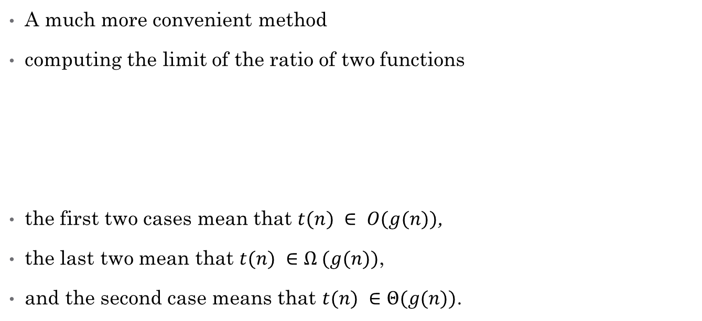
Using Limits for Comparing Orders of Growth
A much more convenient method
computing the limit of the ratio of two functions
the first two cases mean that $t(n) ∈ O(g(n))$,
the last two mean that $t(n) ∈Ω (g(n))$,
and the second case means that $t(n) ∈Θ(g(n))$.

Slide 14
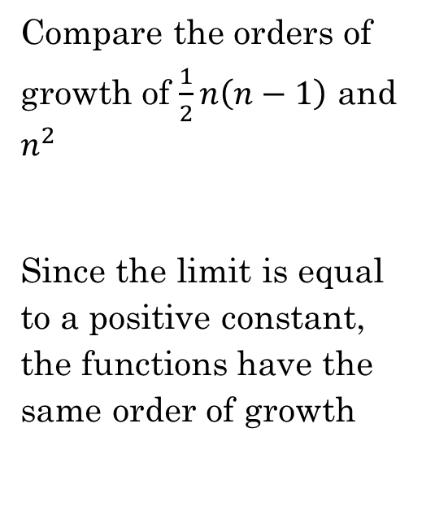

Growth Comparison
$\lim_{n→∞}{\frac{\frac{1}{2}n\left(n−1\right)}{n^{2}}}$
$\frac{1}{2}\lim_{n→∞}{\frac{n\left(n−1\right)}{n^{2}}}$
$\frac{1}{2}\lim_{n→∞}{\frac{\left(n^{2}−n\right)}{n^{2}}}$
$\frac{1}{2}\lim_{n→∞}\left(1−\frac{1}{n}\right)$
$\frac{1}{2}{(1−\frac{1}{∞}})$
$\frac{1}{2}$
Compare the orders of growth of $\frac{1}{2}n\left(n−1\right)$ and $n^{2}$
Since the limit is equal to a positive constant, the functions have the same order of growth

Slide 15
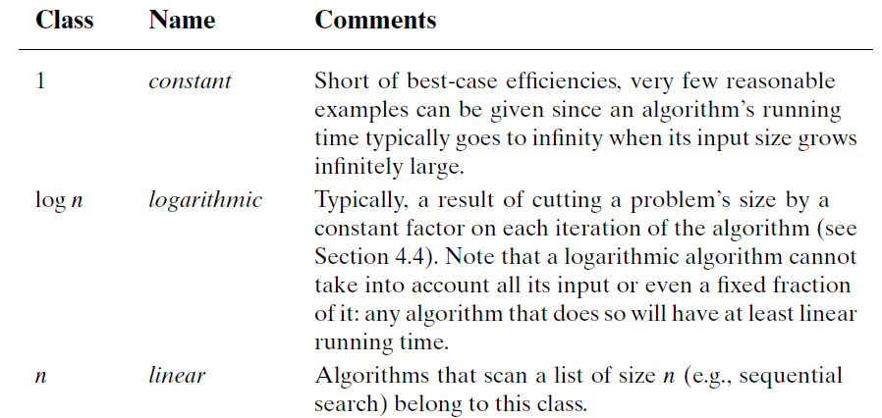
Basic asymptotic efficiency classes

Slide 16
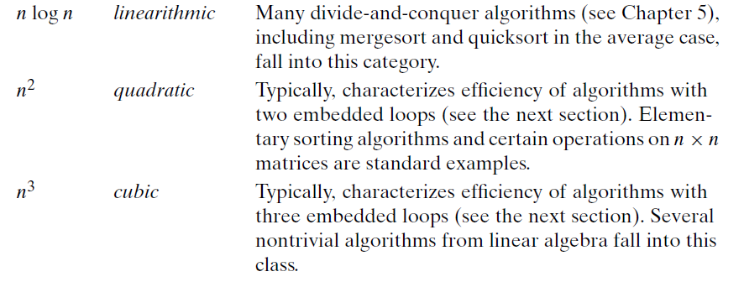
Basic asymptotic efficiency classes

Slide 17
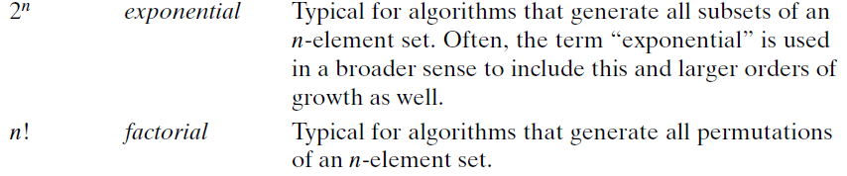
Basic asymptotic efficiency classes

Slide 18
CS2009 Design and Complexity Analysis
Sorting Algorithms

Slide 19
Why we need sorting
What is sorting?
Resorting a set items in prescribed order
7, 3, 8, 2, 5
Ascending 2, 3, 5, 7, 8
Descending 8, 7, 5, 3, 2
Why we need sorting
In academia and industry
Better organization (phone book)
Make other problems easy to be solved (finding median)

Slide 20
Applications of sorting algorithms
Data organization for better utilization
Problems become easy with sorting
Phone book Faster access to contacts
Sorting flights on a screen at an air ports
Sorting items in BestBuy, eBay, amazon, Walmart
Which patient should be seen next at an Emergency Department?
Search engines (google.com , bing.com)
Top related (most relevant) sources in web
Finding median
Finding duplicates in a set
Finding similar values (e.g., find the two numbers with the smallest difference)

Slide 21
Bubble sort
Easy to implement and uses a comparison approach.
Works by performing n-1 passed on the list and after each pass an element is deployed in its right location.
like bubbles rising in a glass of soda, larger elements bubble up to the right of the list in their right place.
Algorithm
Compare each pair of adjacent elements from
the beginning of a list and, if they are in
reversed order, swap them.
If at least one swap has been done, repeat step 1.

Slide 22
Example Bubble sort
n=5 (Needs n-1 passes.)
7 | 2 | 5 | 9 | 1
Pass1 | pass3 | pass3 | pass4
7, 2, 5, 9, 1 2, 7, 5, 9, 1 | 2, 5, 7, 1, 9 2, 5, 7, 1, 9 | 2, 5, 1, 7, 9 2, 5, 1, 7, 9 | 2, 1, 5, 7, 9 1, 2, 5, 7, 9
2, 7, 5, 9, 1 2, 5, 7, 9, 1 | 2, 5, 7, 1, 9 2, 5, 7, 1, 9 | 2, 5, 1, 7, 9 2, 1, 5, 7, 9
2, 5, 7, 9, 1 2, 5, 7, 9, 1 | 2, 5, 7, 1, 9 2, 5, 1, 7, 9
2, 5, 7, 9, 1 2, 5, 7, 1, 9
Sorted
1 | 2 | 5 | 7 | 9

Slide 23
Example Bubble sort

Slide 24
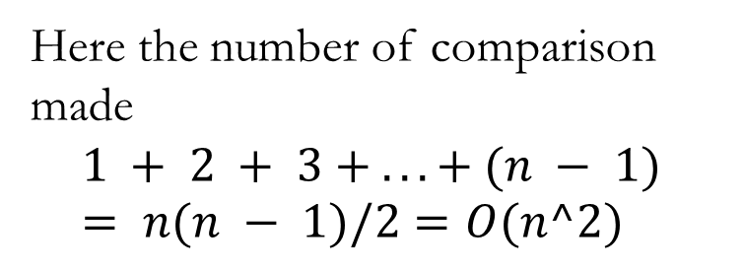
Bubble sort Pseudo-code
SEQUENTIAL BUBBLESORT (A)
for i ← 0 to (length [A]-2) do
for j ← 0 to ((length [A]-2)- i) do
If A[j+1] < A[j] then
Exchange A[j] ↔ A[j+1] //swap
Here the number of comparison made
$$1 + 2 + 3 + . . . + (n − 1) = n(n − 1)/2=O(n^2)$$

Slide 25
About Bubble sort
Inefficient for large data (not really used in practice)
O(n2) sorting algorithm (discussed later)
Here the number of comparison made
1 + 2 + 3 + . . . + (n - 1) = n(n - 1)/2 = O(n2)
Stable Algorithm (discussed later)
In-place
Adaptive (It means that for almost sorted array it gives O(n) estimation)

Slide 26
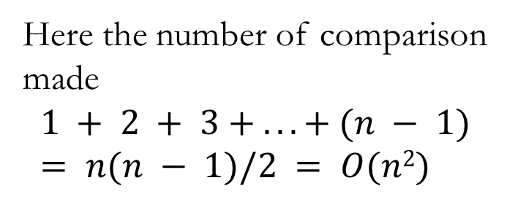
Bubble sort Pseudo-code (different implementation)
SEQUENTIAL BUBBLESORT (A)
for i ← 0 to (length [A] – 1) do
for j ← (length [A]-1) downto i +1 do
If A[j] < A[j-1] then
Exchange A[j] ↔ A[j-1] //swap
Here the number of comparison made
$$1 + 2 + 3 + . . . + (n − 1) = n(n − 1)/2 = O(n2)$$

Slide 27
Example Bubble sort
n=5 (Needs n-1 passes.)
7 | 2 | 5 | 9 | 1
Pass1 | pass3 | pass3 | pass4
7, 2, 5, 9, 1 7, 2, 5, 1, 9 | 1, 7, 2, 5,9 1, 7, 2, 5, 9 | 1, 2, 7, 5,9 1, 2, 7, 5, 9 | 1, 2, 5, 7,9 1, 2, 5, 7, 9
7, 2, 5, 1, 9 7, 2, 1, 5, 9 | 1, 7, 2, 5, 9 1, 7, 2, 5, 9 | 1, 2, 7, 5, 9 1, 2, 5, 7, 9
7, 2, 1, 5, 9 7, 1, 2, 5, 9 | 1, 7, 2, 5, 9 1, 2, 7, 5, 9
7, 1, 2, 5, 9 1, 7, 2, 5, 9
Sorted
1 | 2 | 5 | 7 | 9

Slide 28
About
Inefficient for large data and not really used in practice (very rarely)
O(n2) sorting algorithm
Here the number of comparison made
1 + 2 + 3 + . . . + (n - 1) = n(n - 1)/2 = O(n2)
Stable Algorithm
Adaptive (It means that for almost sorted array it gives O(n) estimation)

Slide 29
Stability
Example: The process of determining the next patient to be seen at Emergency Department (when resources are insufficient for all to be treated immediately)
If two items have the same key as each other, they should have the same relative position in the output as they did in the input.
Emergency Severity Index EDI (time stamp)
5 (4:00 am) | 5 (4:05 am) | 10 (4:11 am) | 8 (4:15 am) | 10 (4:17 am)
10 (4:11 am) | 10 (4:17 am) | 8(4:15 am) | 5 (4:00 am) | 5(4:05 am)

Slide 30
Selection Sort
Works by finding the minimum value and swap it with first location
finds the next minimum and swap it with the second element.
Continue the same process until all list is sorted.

Slide 31
Example Selection Sort
unsorted
[0] [1] [2] [3] [4]
7 | 2 | 5 | 9 | 1
Pass1 | pass3 | pass3 | pass4
7, 2, 5, 9, 1 Min in index=4 1, 2, 5, 9, 7 | 1, 2, 5, 9, 7 index=1 1, 2, 5, 9, 7 | 1, 2, 5, 9, 7 index=2 1, 2, 5, 9, 7 | 1, 2, 5, 9, 7 Index=4 1, 2, 5, 7, 9
sorted
1 | 2 | 5 | 7 | 9

Slide 32
Example Selection Sort

Slide 33
Pseudo-code - Selection sort
1. for j ← 0 to n-2
2. smallest ← j
3. for i ← j + 1 to n-1
4. if A[ i ] < A[ smallest ]
5. smallest ← i
6. Exchange A[ j ] ↔ A[ smallest ]
Finding the minimum
Inefficient in terms of time complexity (will discuss that later on)

Slide 34
About Selection Sort
In-place (insignificant extra memory)
Comparison based algorithm
Inefficient for large data
huge time proportional to size of the data (O(n²) sorting algorithm)
Here the number of comparison made
1 + 2 + 3 + . . . + (n - 1) = n(n - 1)/2 ----> O(n²)
Not Stable
(can be stable with little change in the implementation)

Slide 35
Why Selection Sort Is Not Stable!!!
Selection sort exchanges elements from the front of the list with the minimum element, which can change the original order of the elements.
For example, (EDI, Time)
(8, 4:10), (8, 4:15), (10, 4:12)
Selection sort first swaps the (10, 4:12) to the front:
(10, 4:12), (8, 4:15), (8, 4:10)
And now the (8, 4:15) and (8, 4:15) are out of order from where they started in the sort.
Can be stable if an insertion technique is used instead of swapping in a small time

Slide 36
Insertion sort
Applied in practice for sorting small lists of data.
List is imaginary divided into two parts - sorted one and unsorted one.
sorted
7 | 2 | 5 | 9 | 1
unsorted

Slide 37
Insertion sort
At the beginning, sorted part contains first element of the array and unsorted one contains the rest.
At every step, algorithm takes first element in the unsorted part and inserts it into its correct position in the sorted one.
2 | 7 | 5 | 9 | 1
sorted
unsorted
When unsorted part becomes empty, algorithm stops.

Slide 38
Example – insertion sort
7 | 2 | 5 | 9 | 1
2 | 5 | 7 | 9 | 1
7 | 2 | 5 | 9 | 1
2 to be inserted
7>2 ---> swap
Reached left boundary so insert 2
2 | 5 | 7 | 9 | 1
2 | 7 | 5 | 9 | 1
sorted
unsorted
2 | 5 | 7 | 9 | 1
sorted
unsorted
2 | 5 | 7 | 1 | 9
2 | 7 | 5 | 9 | 1
2 | 5 | 1 | 7 | 9
2 | 5 | 7 | 9 | 1
2 | 1 | 5 | 7 | 9
2 | 5 | 7 | 9 | 1
Insert 5
1 | 2 | 5 | 7 | 9
sorted
unsorted
sorted

Slide 39
Example – insertion sort

Slide 40
Insertion sort, pseudo-code
1: for i ← 1 to i < list.size
2: j ← i
3: while j > 0 and list[j - 1] > list[j]
4: tmp ← list[j];
5: list[j] ← list[j - 1];
6: list[j - 1] ← tmp;
7: j ← j-1
// Swap (list[j] and list[j-1])

Slide 41
About Insertion Sort
Inefficient for large data
O(n2) sorting algorithm (huge time proportional to size of the data)
Here the number of comparison made
1 + 2 + 3 + . . . + (n - 1) = n(n - 1)/2 ----> O(n²)
Stable
Correct (Loop Invariant)
In-place (No significant extra memory)
Time is proportional to the number of the inversions
Better when list is almost sorted o(k+n) : k is inversions number.

Slide 42
CS2009 Design and Complexity Analysis
Loop Invariant

Slide 43
Loop Invariant
Proving loop invariants works like mathematical induction
Initialization (base case):
It is true prior to the first iteration of the loop
Maintenance (inductive step):
If it is true before an iteration of the loop, it remains true before the next iteration
Termination:
When the loop terminates, the invariant gives us a useful property that helps show that the algorithm is correct
Stop the induction when the loop terminates

Slide 44
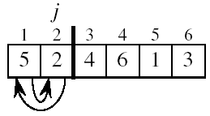
Initialization
Just before the first iteration, j = 2:
the subarray A[1 . . j-1] = A[1], (the element originally in A[1]) – is sorted

Slide 45
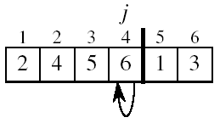
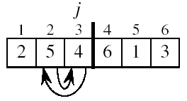
Maintenance
The while inner loop moves A[j -1], A[j -2], A[j -3], and so on, by one position to the right until the proper position for key (which has the value that started out in A[j]) is found
At that point, the value of key is placed into this position.

Slide 46

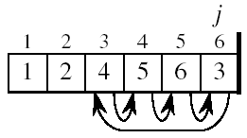
Termination
The outer for loop ends when j = n + 1 ⇒ j-1 = n
Replace n with j-1 in the loop invariant:
the subarray A[1 . . n] consists of the elements originally in A[1 . . n], but in sorted order
The entire array is sorted!
Invariant: at the start of the for loop the elements in A[1 . . j-1] are in sorted order
j - 1
j

Slide 47
Which Algorithm Is Better For Me?
Time complexity
Dependency relation between size of data and time (time proportional to size of data)
How time evolve if size of data is increased?
Space complexity
In-place (insignificant amount of extra storage)
Auxiliary storage (grows with input size)
Stability
Preserve original ranks for items with same key values
Others
Recursive, comparison, linear, internal vs external storage

Slide 48
Summary of Sorting Algorithms
Algorithm | Time | Notes
bubble-sort | O(n²) | -in-place -slow (good for small inputs)
selection-sort | O(n²) | -in-place -slow (good for small inputs)
insertion-sort | O(n²) | -in-place -slow (good for small inputs)

Slide 49
CS2009 Design and Complexity Analysis
Linear Sorting Algorithms

Slide 50
Linear time sorting algorithms
Counting sort and radix sort assume that the input consists of integers in a small range.
Despite of linear time usually these algorithms are not very desirable from practical point of view
the efficiency of linear-time algorithms depend on the keys randomly ordered. If this condition is not satisfied, the result is the degrading in performance.
these algorithms require extra space proportional to the size of the array being sorted and largest value of the elements, so if we are dealing with large file, extra array becomes a real liability

Slide 51
Counting Sort
it is an integer sorting algorithm.
Note that Counting sort beats the lower bound of Ω(n lg n), because it is not a comparison sort. O(n + k)
Counting sort uses the actual values of the elements to index into an array.
The basic idea of Counting sort is to determine, for each input elements x, the number of elements less than x.
Not in-place Because it uses arrays of length k + 1 and n, the total space usage of the algorithm is also O(n + k)

Slide 52
Example, Counting Sort
C[0] [1] [2] [3]
for j ← 0 to Max do
c[A[j]] ← c[A[j]] + 1
A
3 | 2 | 3 | 1 | 1
C
0 | 2 | 1 | 2
for j ← n-1 downto 0 do
B[c[A[j]] -1] ← A[j]
c[A[j]] ← c[A[j]] - 1
C
0 | 2 | 3 | 5
for j ← 1 to Max do
c[A[j]] ← c[A[j]] + 1
B
- | 1 | - | - | -
C
0 | 1 | 3 | 5
B
1 | 1 | - | - | -
C
0 | 0 | 3 | 5
B
1 | 1 | - | - | 3
C
0 | 0 | 3 | 4
B
1 | 1 | 2 | - | 3
C
0 | 0 | 2 | 4
B
1 | 1 | 2 | 3 | 3
C
0 | 0 | 2 | 3

Slide 53
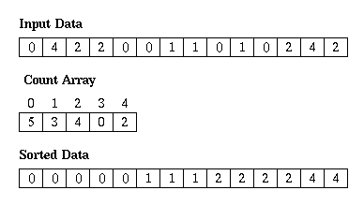
Example, Counting Sort

Slide 54
Pseudo-code, counting sort
COUNTING_SORT (A, B, k)
1. for i ← 0 to k-1 do
2. c[i] ← 0
3. for j ← 0 to n-1 do
4. c[A[j]] ← c[A[j]] + 1
//c[i] now contains the number of elements equal to i
5. for i ← 1 to k-1 do
6. c[i] ← c[i] + c[i-1]
// c[j] now contains the number of elements ≤ j
7. for j ← n-1 downto 0 do
8. B[c[A[j]] -1] ← A[j]
9. c[A[j]] ← c[A[j]] - 1
Analysis
The loop of lines 1-2 takes O(k) time
The loop of lines 3-4 takes O(n) time
The loop of lines 5-6 takes O(k) time
The loop of lines 7-9 takes O(n) time
Overall time of the counting sort is
O(k) + O(n) + O(k) + O(n) = O(k + n)

Slide 55
Summary of Sorting Algorithms
Algorithm | Time | Notes
bubble-sort | O(n²) | -in-place -slow (good for small inputs)
selection-sort | O(n²) | -in-place -slow (good for small inputs)
insertion-sort | O(n²) | -in-place -slow (good for small inputs)
counting sort | O(n + k) : k is max items value | -not a comparison sort -Work with integers

Slide 56
Radix Sort

Slide 57
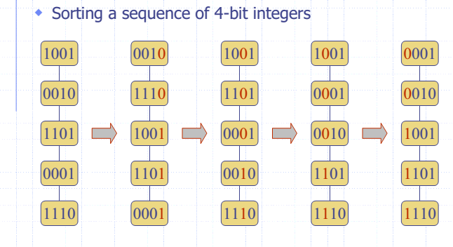
Radix Sort
Linear time
Works with numbers or data in form of numbers.
Stable
O(n+k)
***Algorithms design. By Goodrich

Slide 58
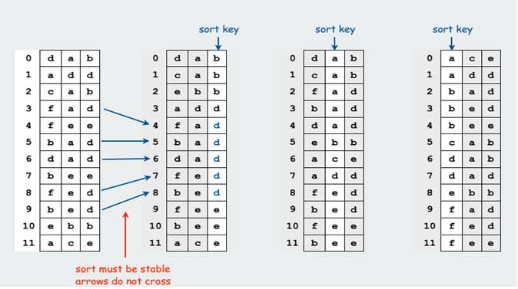
Least significant digit radix sort

Slide 59
Algorithm
Algorithm
Execution
void radixsort(arr[]):
m = getMax(arr), digits=log(m,10)
for d in digits:
countSort(arr, d)
arr={170, 45, 75, 90, 802, 24, 2, 66}
m=802, digit=3
d=1:
arr={170, 90, 802, 2, 24, 45, 75, 66}
d=2:
arr={802, 2, 24, 45, 66, 170, 75, 90}
d=3:
arr={2, 24, 45, 66, 75, 90, 170, 802}

Slide 60
Practical observation
Elements to be ordered are usually objects/structures (struct) made of many variables ( members/fields)
The key of such object/structure is usually one member/field (or a value calculated from one or more members/fields)
Remaining members/fields are additional data but usually useless for ordering
Ordering is made for increasing values (ascending order) of the key
People tend to use comparison based sorting algorithms although other algorithm types some times faster e.g., Radix. (avoid complex implementations)

Slide 61
Summary of Sorting Algorithms
Algorithm | Time | Notes
bubble-sort | O(n²) | -in-place -slow (good for small inputs)
selection-sort | O(n²) | -in-place -slow (good for small inputs)
insertion-sort | O(n²) | -in-place -slow (good for small inputs)
counting sort | O(n + k) : k is max items value | -not a comparison sort -Work with integers
radix sort | O(n + k) | -not a comparison sort

Slide 62
Bucket Sort

Slide 63
Bucket Sort Algorithm
bucketSort(arr[], n):
Create n empty buckets (Or lists).
Do following for every array element arr[i].
Insert arr[i] into bucket[n*array[i]]
Sort individual buckets using insertion sort.
Concatenate all sorted buckets.

Slide 64
Bucket Sort Code
void bucketSort(float arr[], int n) :
vector<float> b[n]
for (int i = 0; i < n; i++):
int bi = n * arr[i]
b[bi].push_back(arr[i])
for (int i = 0; i < n; i++):
sort(b[i].begin(), b[i].end())
int index = 0
for (int i = 0; i < n; i++):
for (int j = 0; j < b[i].size(); j++):
arr[index++] = b[i][j]

Slide 65
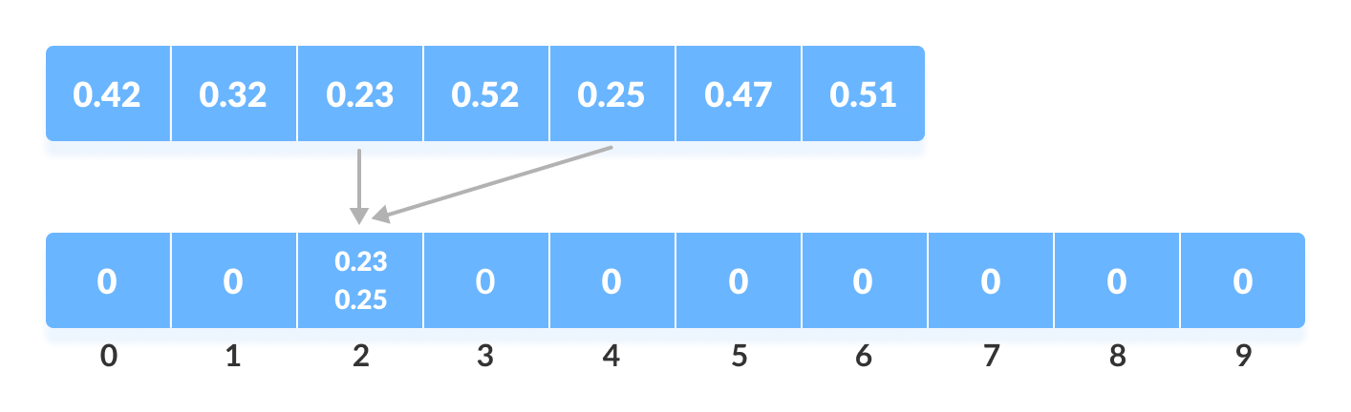
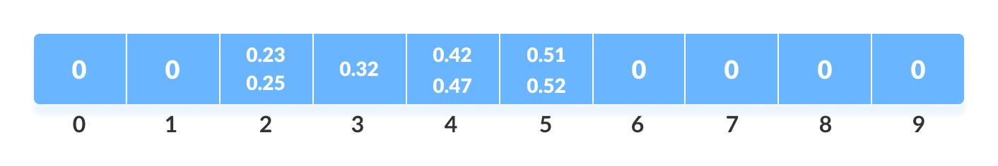
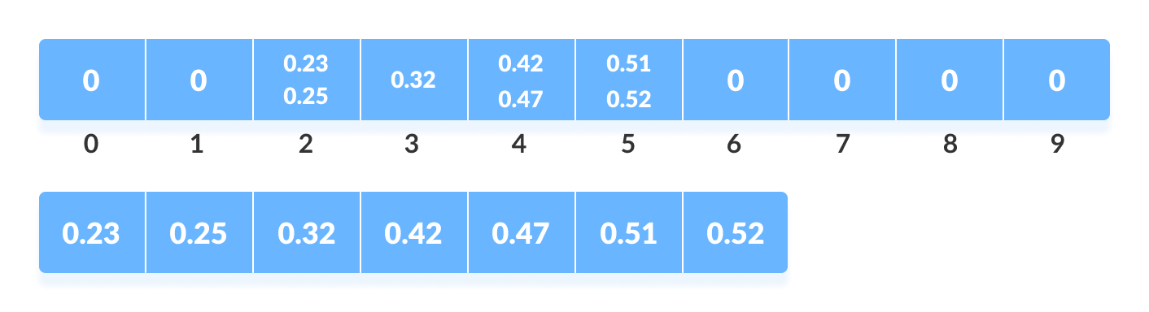

Slide 66
Summary of Sorting Algorithms
Algorithm | Time | Notes
bubble-sort | O(n²) | -in-place -slow (good for small inputs)
selection-sort | O(n²) | -in-place -slow (good for small inputs)
insertion-sort | O(n²) | -in-place -slow (good for small inputs)
counting sort | O(n + k) : k is max items value | -not a comparison sort -Work with integers
radix sort | O(n + k) | -not a comparison sort
Bucket Sort | O(n) | -not a comparison sort

